Slide 1
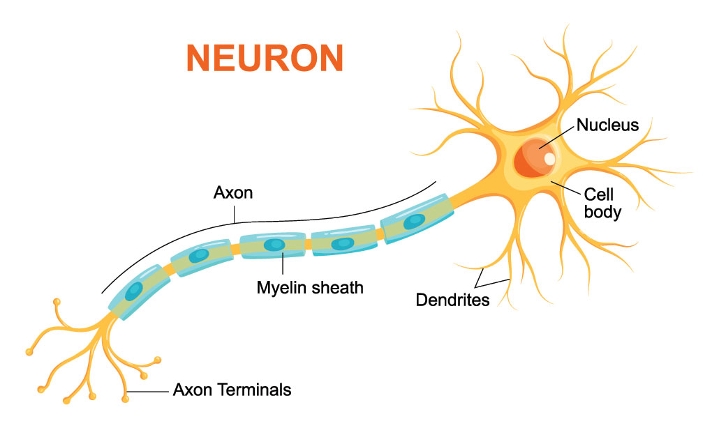


Slide 2
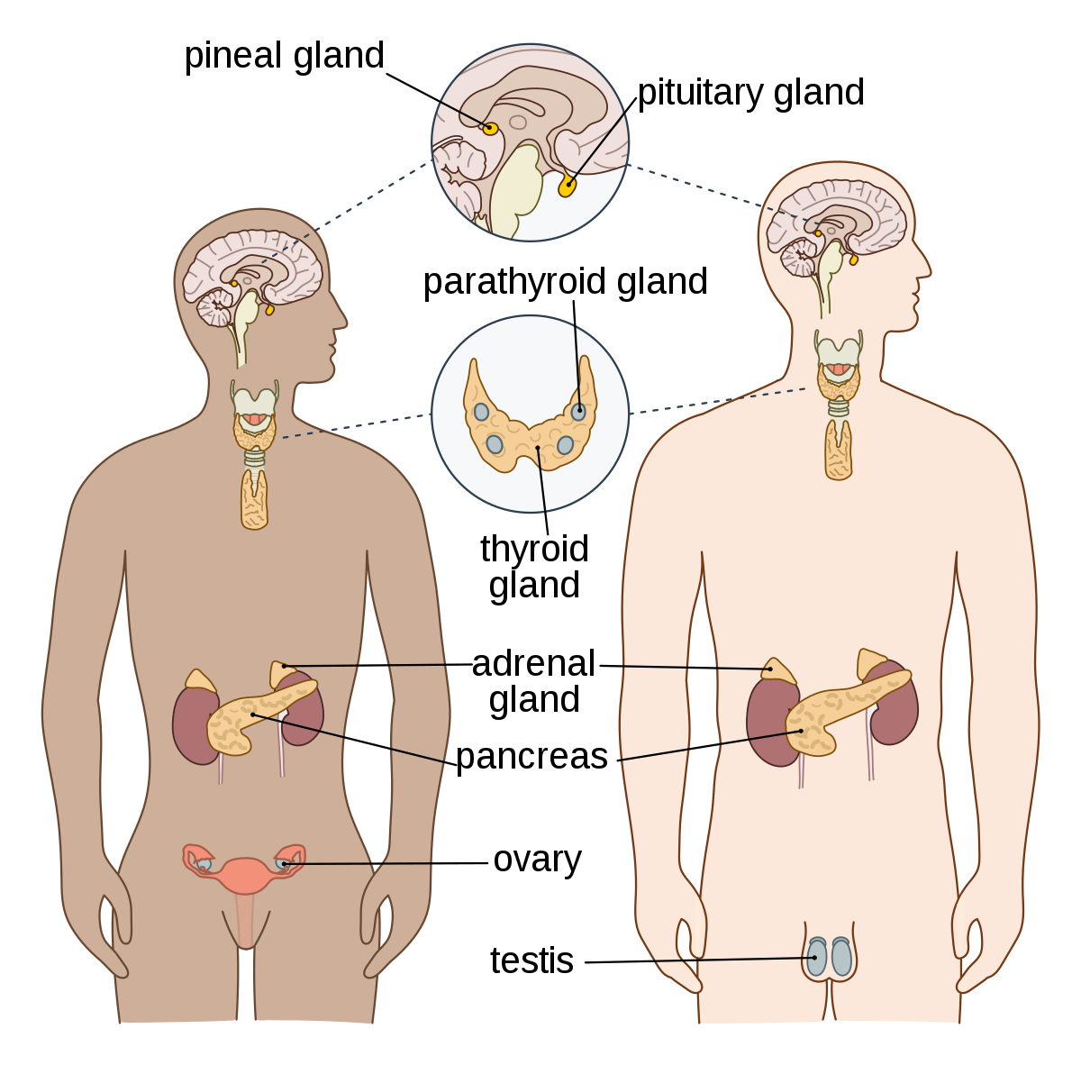
Whiteboards:
Notes:
Allow pair work time, then call on non-volunteers for the answers, or read through the text again as a class, filling the gaps in unison.

Slide 3
What are the 5 releasing and inhibiting factors produced by the hypothalamus?
Gonadotropic hormones:
Follicle Stimulating Hormone
Luteinizing Hormone
2. Growth Hormone
3. Thyroid Stimulating Hormone (TSH)
4. Adrenocorticotropic Hormone (ACTH)
5. Prolactin/Lactogenic Hormone
Notes:
Have the class read/track in unison with you.

Slide 4
What are the 2 hormones stored/secreted from the posterior lobe
Oxytocin (OT)
Antidiuretic Hormone (ADH)

Slide 6
Students will be able to:

Slide 8
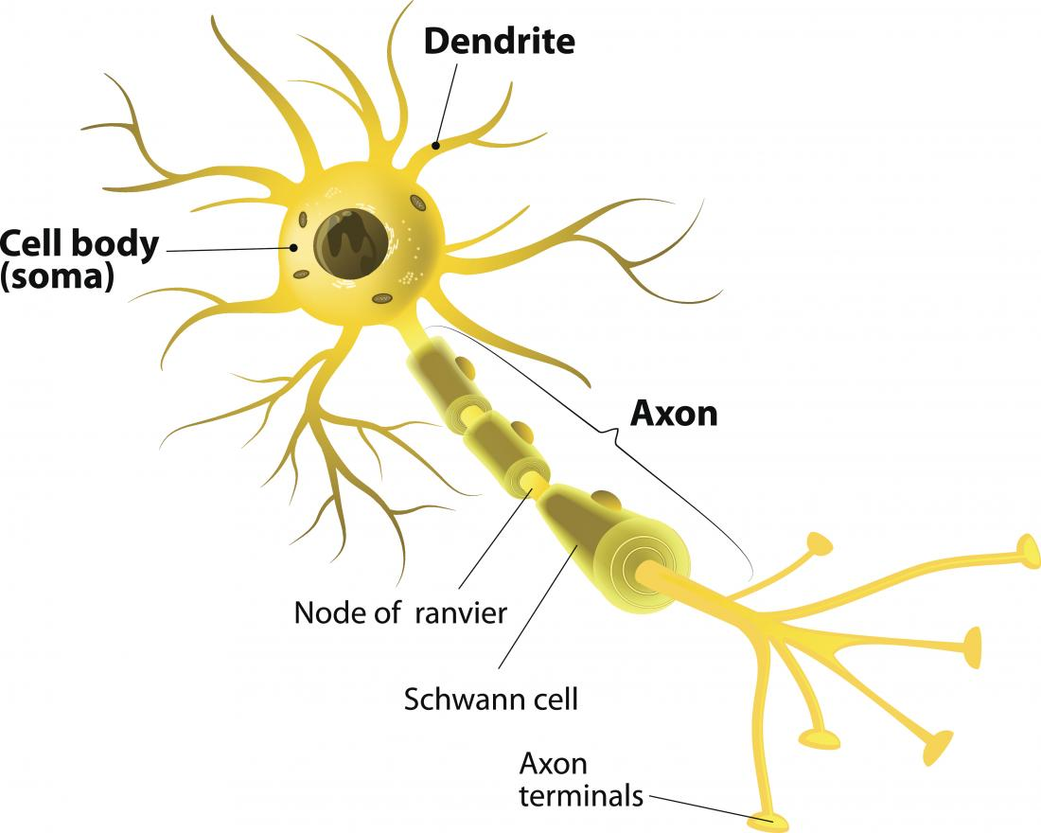
Neurons, Nerve Fibres, and Nerves
Nerve cells, or neurons, are the fundamental unit of the nervous system.
The cells consist of cell bodies containing the nucleus, cytoplasm, and or organelles (e.g. mitochondria, Golgi apparatus, ribosomes).
From the cell body there are branching extensions of cytoplasm that allow for communication between adjacent neurons: the axon and dendrite.
Notes:
Teacher Cue – refer to the vocabulary box as you read through and “unpack” the definition provided. Use hand gestures to emphasise the ”2 or more”, “mixed” and “separated” parts of the definition.
Have students complete CFU 1 as a pair-share, then record these definitions & examples as notes (with diagrams) if desired.
CFU 2 – pair-share, then whiteboards for answers – call on non-volunteers.

Slide 9
Neurons, Nerve Fibres, and Nerves
Axon: usually longer than the dendrite; responsible for carrying nervous impulses away from the cell body.
Dendrite: responsible for carrying nervous impulses towards the cell body.
Notes:
CFU – read through the slide, have students look closely at the diagram, then allow think time, before asking them to explain it to their partner using the key terms pure substance and mixture. Call on non-volunteers and provide feedback, encouraging detailed responses in full sentence form.

Slide 10
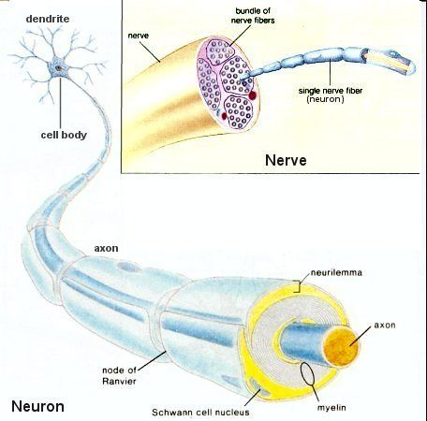
Neurons, Nerve Fibres, and Nerves
Collectively, dendrites and axons (extensions) are called nerve fibres. Fibres are gathered together by connective tissue sheaths outside the central nervous system and form nerves.
Notes:
CFU – read through the slide, have students look closely at the diagram, then allow think time, before asking them to explain it to their partner using the key terms pure substance and mixture. Call on non-volunteers and provide feedback, encouraging detailed responses in full sentence form.

Slide 11
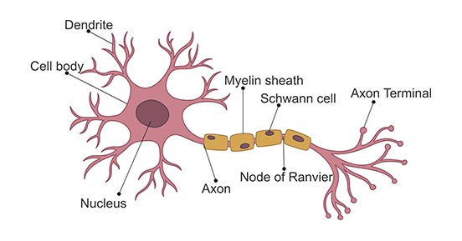
Neurons, Nerve Fibres, and Nerves
Axons can be myelinated, meaning they are sheathed with a fatty substance called myelin.
Outside the central nervous system, this myelin sheath is produced by Schwann cells which wrap around the length of the axon.
This produces gaps in the sheath that are known as the Nodes of Ranvier.
The outer layer of the Schwann cell is known as the neurilemma, which promotes the repair of injured fibres.

Slide 12
The myelination offer three main functions:
1. Insulation
2. Protection of the fibre from damage
3. Accelerating the rate of impulse transmission along the axon.

Slide 13
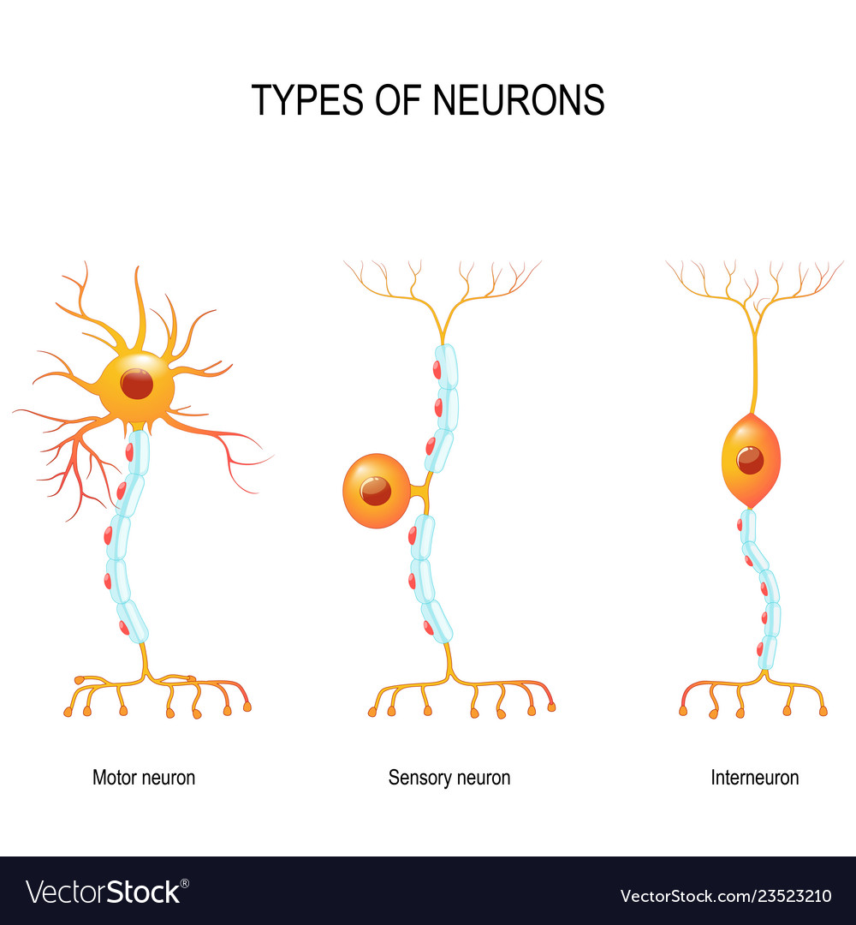
Neurons can be classified in two main ways: functionally and structurally.
Function of neurons
Sensory neurons: carry nervous impulses from the receptors in sensory organs/tissues to the central nervous system.
Motor neurons: carry nervous impulses from the central nervous system to glands and muscles (collectively known as effectors).
Interneurons: link sensory neurons to motor neurons within the central nervous system.

Slide 14
Neurons can be classified in two main ways: functionally and structurally.
Structure of neurons
Multipolar: 1 axon, multiple dendrites
Bipolar: 1 axon, 1 dendrite
Unipolar: 1 axon, cell body to one side

